Slide 1




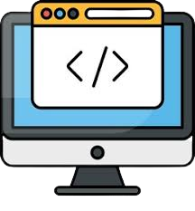

Programming
Compiler
IDE
C programming-language
Programming Necessity
PROGRAM

Slide 2

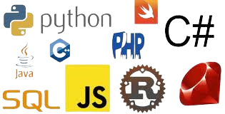
A set of written instructions to process a specific tasks/commands in a high speed.
A form of communication
So simple
Programming Language
A written type language that tells computer what to do.
Computer softwares and applications are made by these programming languages.
WHAT IS PROGRAMMING
???
Programming
Languages are:
C and C++
PYTHON
JAVA
SQL
SWIFT
PHP
RUBY
CSS and HTML etc

Slide 3
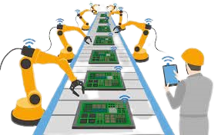


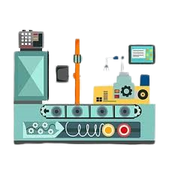



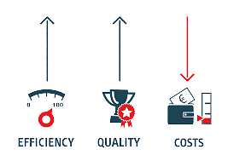


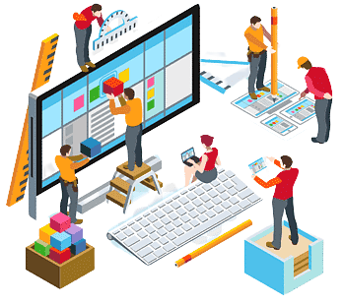
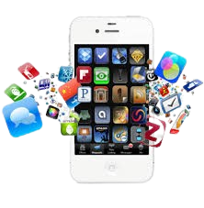




Have good communication skills, being social
Learn about more coding languages but be specialized in one.
self-reliance and problem solver
Defining the problem
Planning the solution
Coding the program
Testing the program
Documenting the program
Processing Speed
Accuracy
Multi-tasking
Storage
Reduce cost
Design
Develop
Test software
Performance
Security
Finger print
Mobile
Heavy machines
Automation
satellite
Wow!!
So interesting.
Why
Programming
Benefits
Tasks
Applications
How to Start

Slide 4


IN BRIEF TO C LANGUAGE
1972
Bell Laboratories
of USA
American computer scientist
developed the C programming
Ok I got this but what thing caused to developed C programming
To write the
UNIX operating system
Most popular language, despite older
General-purpose and procedural language
Named
Dennis MacAlistair Ritchie

Slide 5
THANKS FOR WATCHING
Like and share the video
Drop related question if any
Subscribe and click the bell button for more updates.
Instagram
Facebook
TikTok
Telegram

